Slide 1

Pixel Divine
An IT Consultancy Company

Slide 2
Presentation Outline
Company profile
Services
Portfolio
Our features
Contact us

Slide 3
Company Profile
Pixel Divine
Intercepted in 2015
An IT Consultancy Company
Team of dedicated and motivated professionals
Deal with Information technology, web development and computer applications.

Slide 4
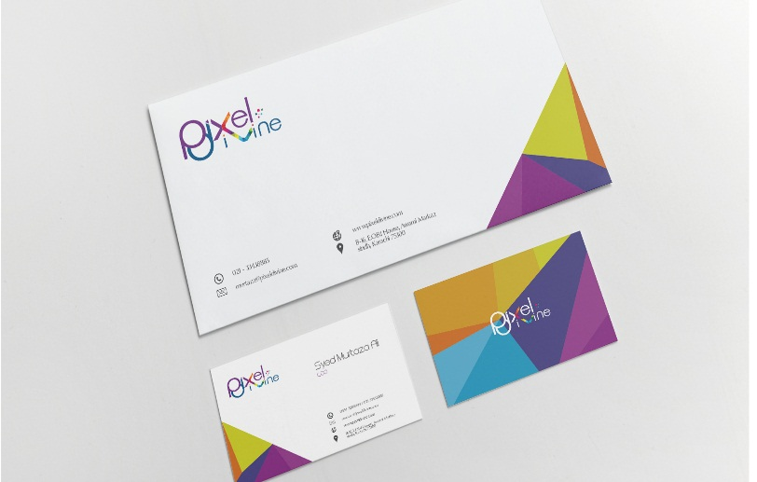
Services
Branding
    Graphic design
    Logo design
    Stationary
    Print design
    Packaging design
Web and digital design
    Website design
    Web custom and graphic design
    PSD to HTML
Development
    Custom web development
    Mobile Apps development
    WordPress development services

Slide 5



Portfolio
Academic Assistance
Academic paper help
Divine content
Online Study Pro
Top Essay Help
Top Dissertation Help
Top writing Help
UK nursing Essays
UK online dissertations

Slide 6
Our features
Software development
System administration
IT consultancy
Data center design
Private cloud design

Slide 7
Contact Us
CONTACT HOURS
MONDAY – FRIDAY: 01:00 – 09:00 (PST)
SATURDAY – SUNDAY: 03:00 – 09:00 (PST)
ADDRESS
PLOT # 26C, MUSLIM COMM. STREET 2. PHASE – VI. DHA, KARACHI, PAKISTAN
CALL US
021-35155713
EMAIL US
info@pixeldivine.com

Slide 8
Thank you

